Slide 1
Real vs. Ideal Westward Expansion in the U.S.

Slide 2
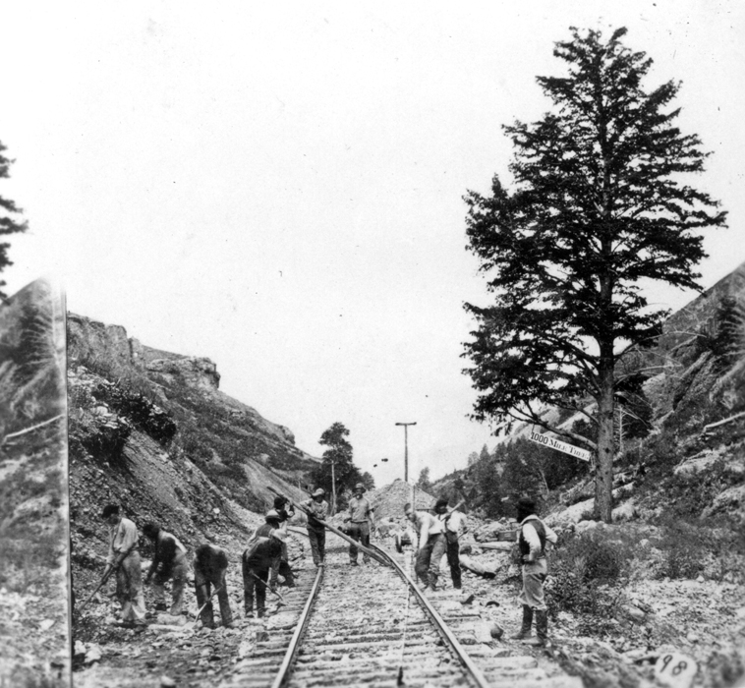
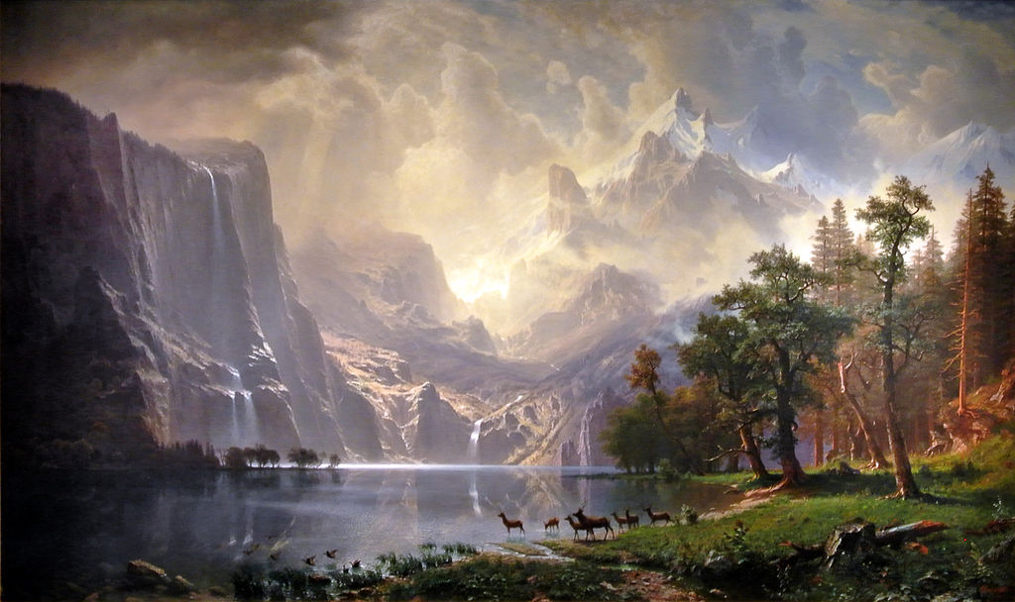
Bierstadt, A. (1868). Among the Sierra Nevada Mountains, California. Washington, D.C.: Smithsonian American Art Museum.
Jackson, W.H. (1869). Thousand Mile Tree. U.S. Geological Survey Photographic Library. Weber County, UT.

Slide 3
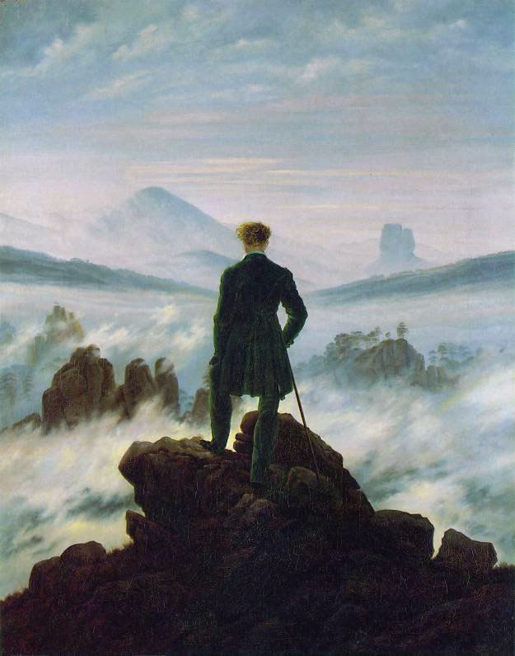
Friedrick, C.D. (1818). Wanderer Above the Sea of Fog.
Romantic Art
Full of imagination
Dramatic
Mysterious
Emotional
Focused on feelings
Idealized
Spiritual
Celebrates nature

Slide 4
Turner, J.M.W. (1829). Ulysses Deriding Polyphemus. National Gallery, London.

Slide 5
Real Life
Image Credit: Rachel Jackson

Slide 6
Romanticized
Image Credit: Rachel Jackson

Slide 7
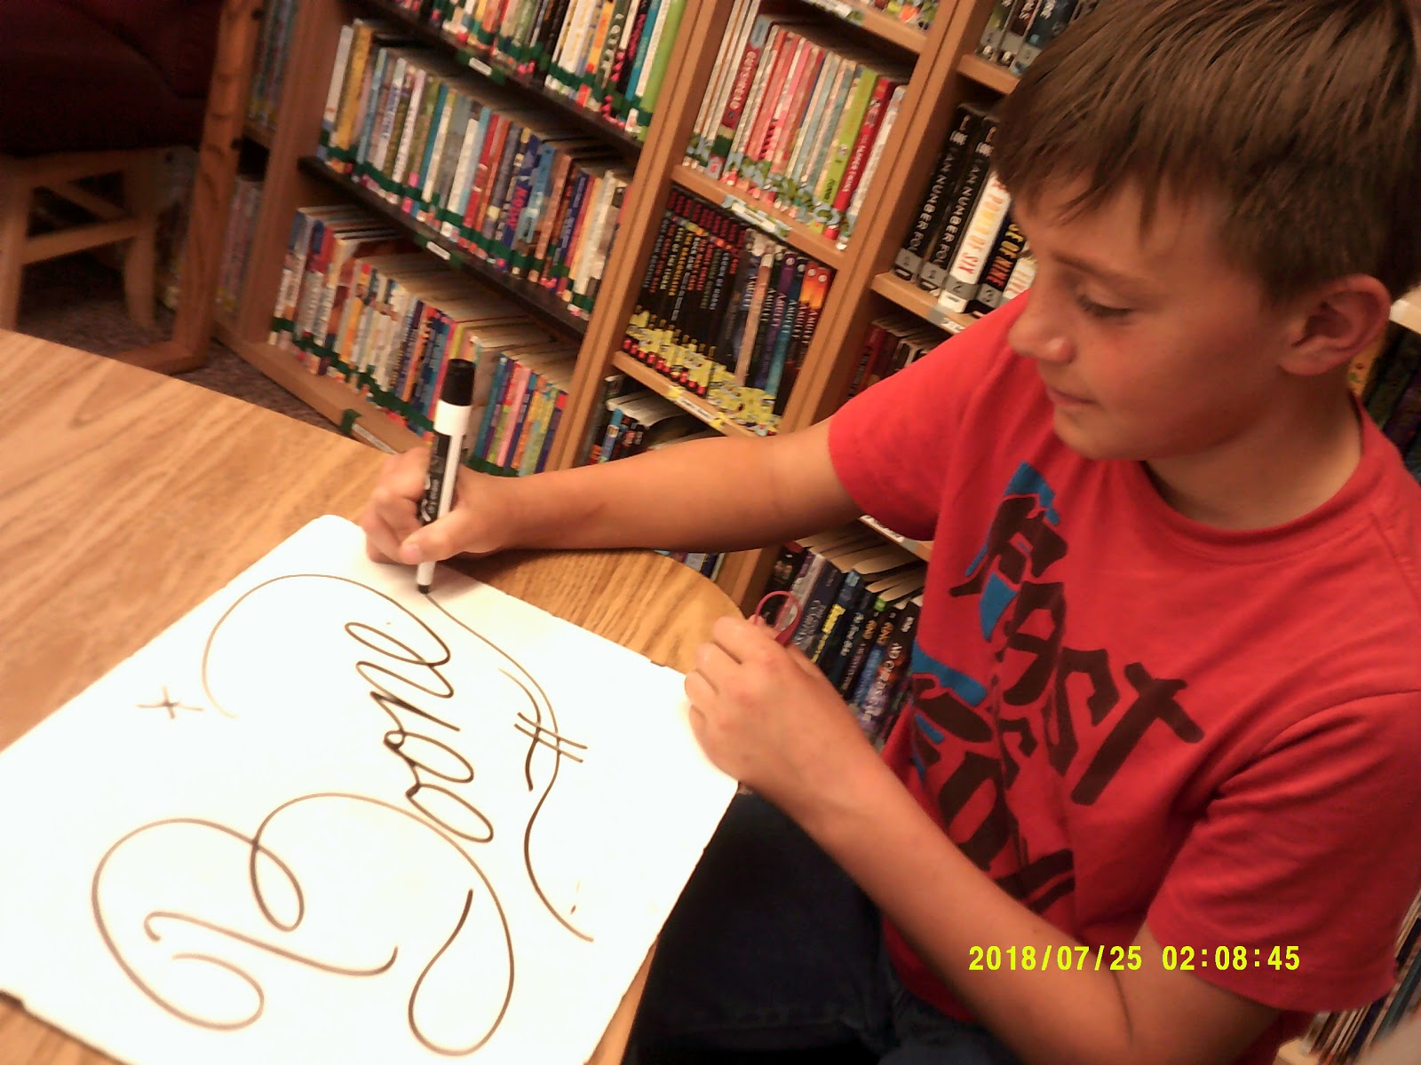
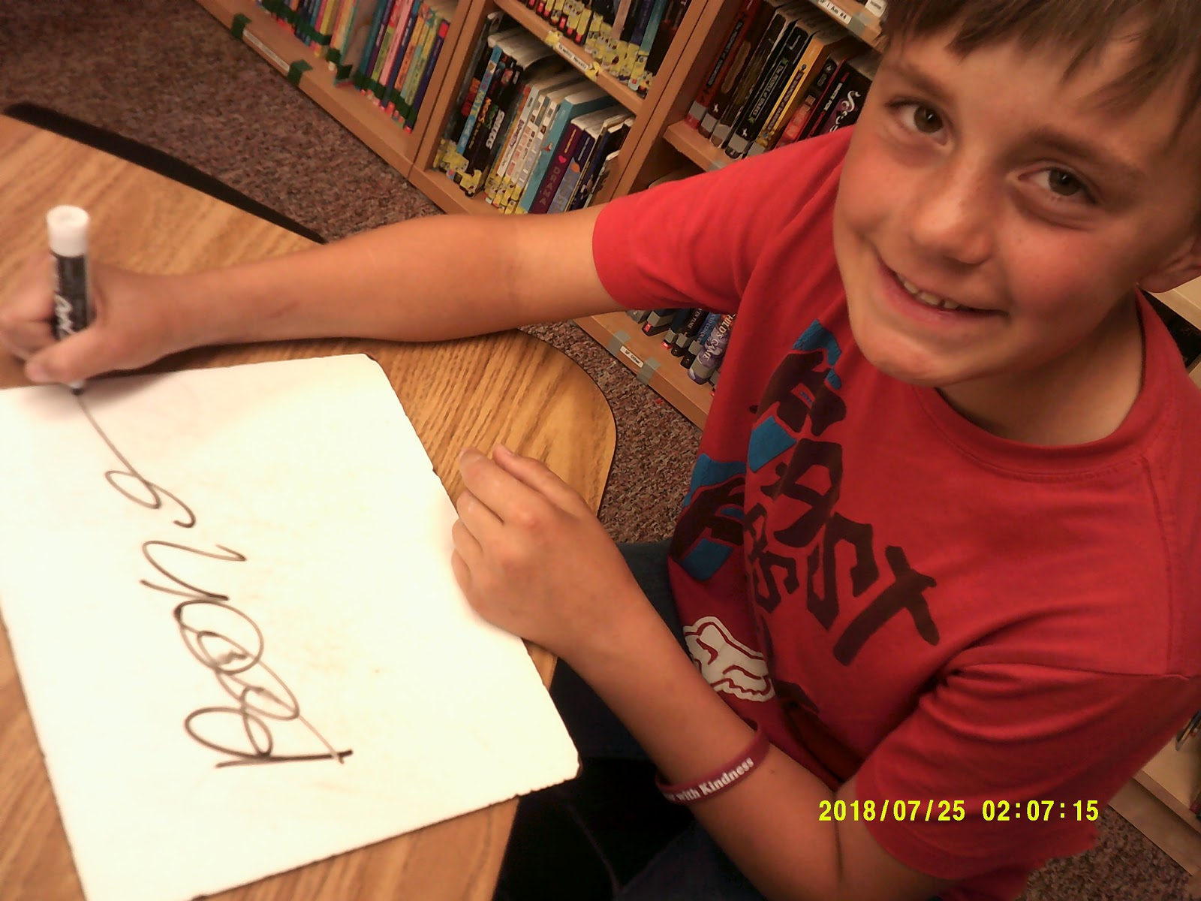
Student Examples

Slide 8
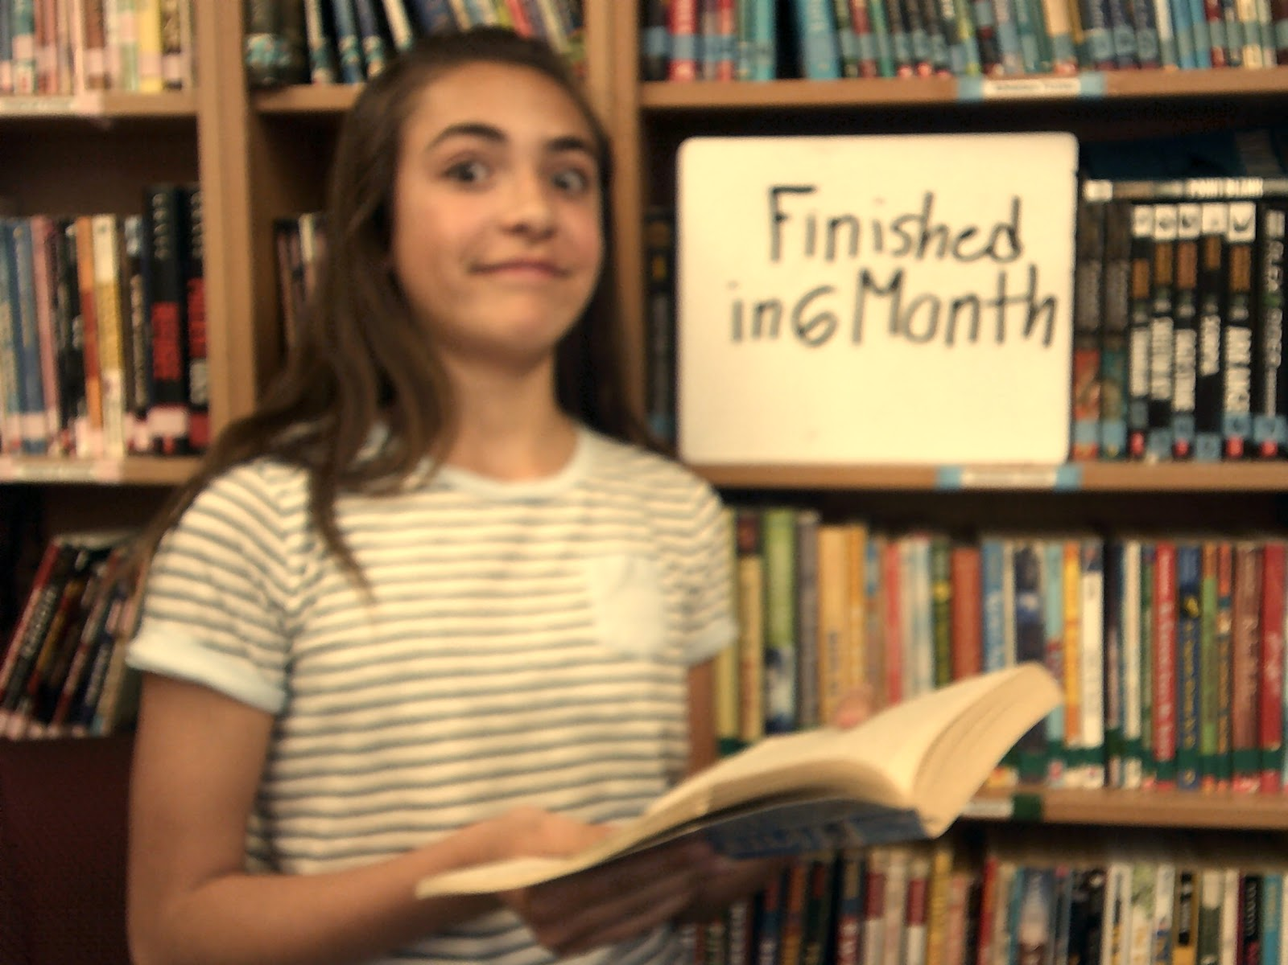

Slide 9
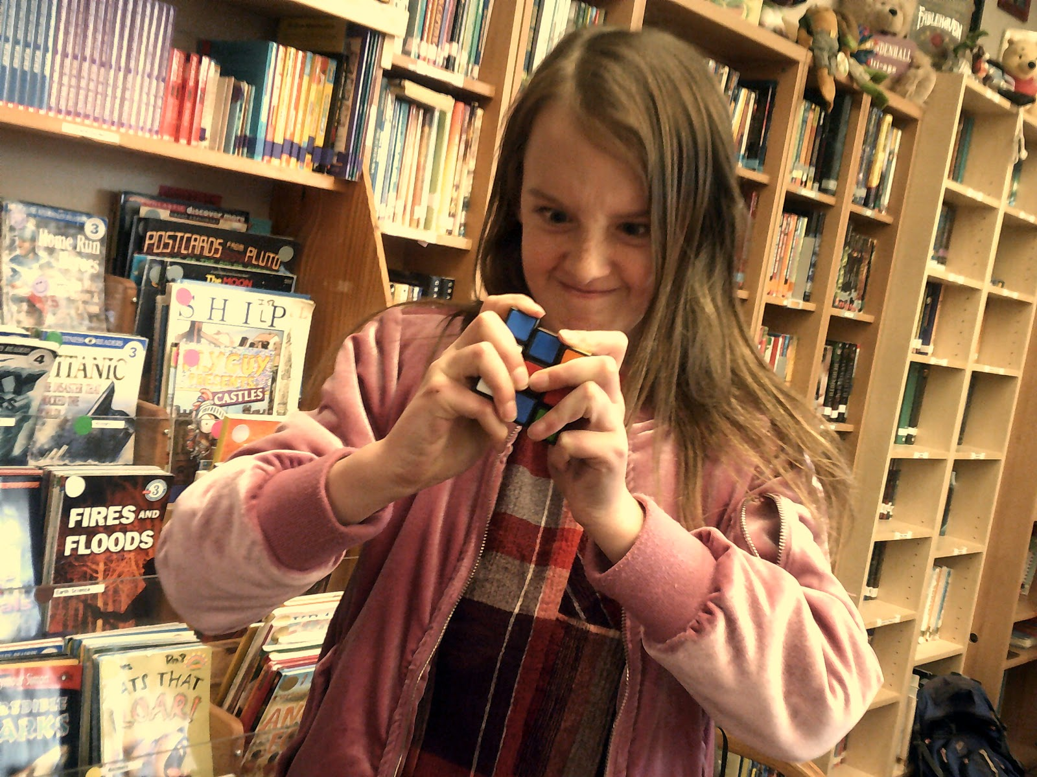

Slide 11
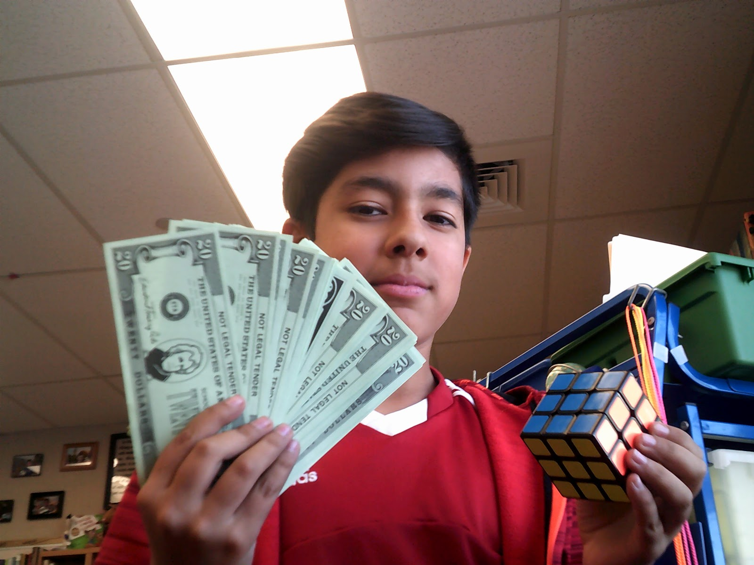

Slide 12
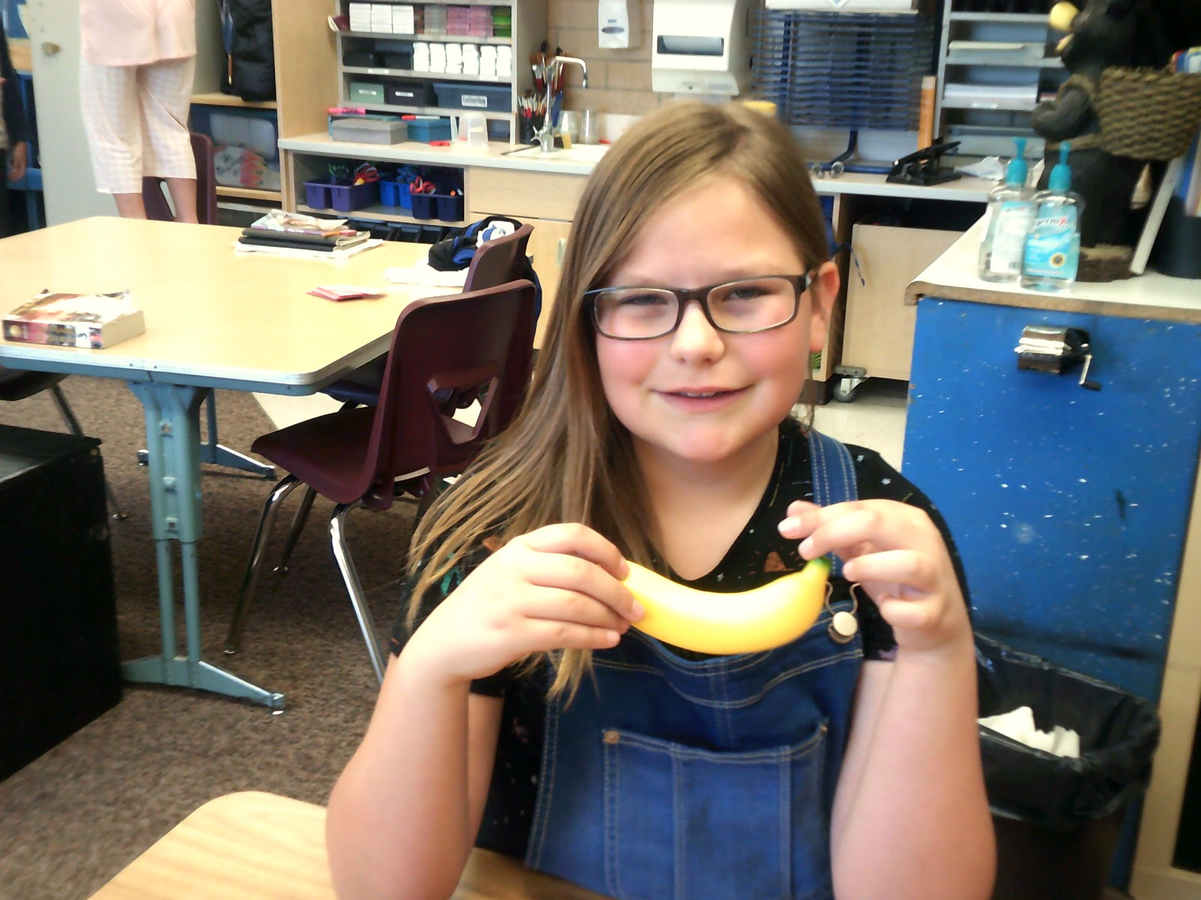
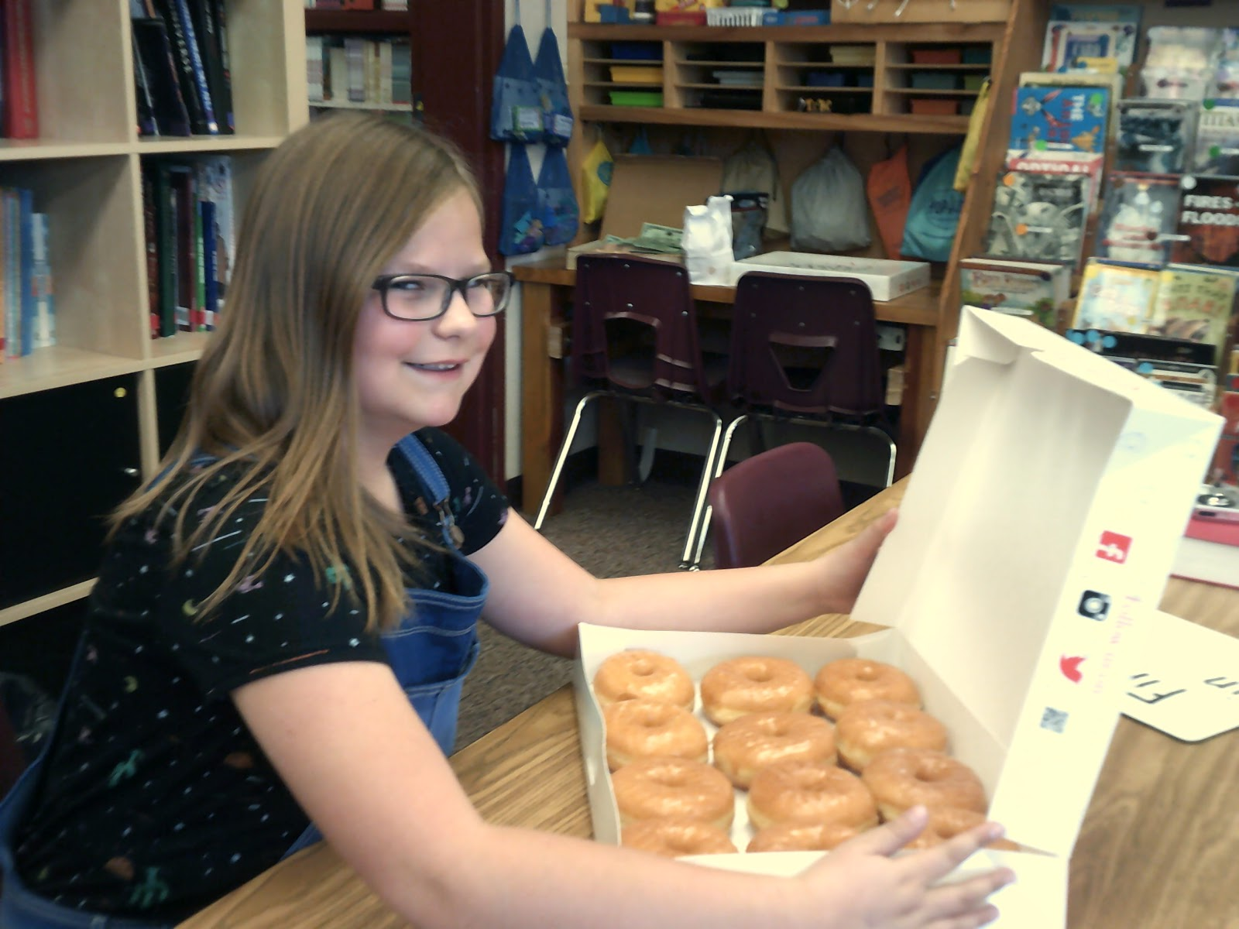

Slide 13
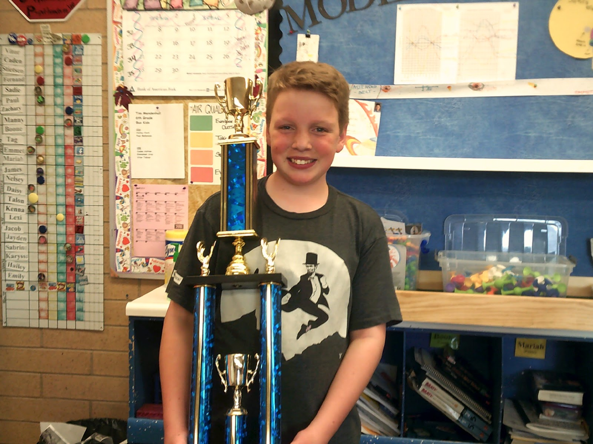
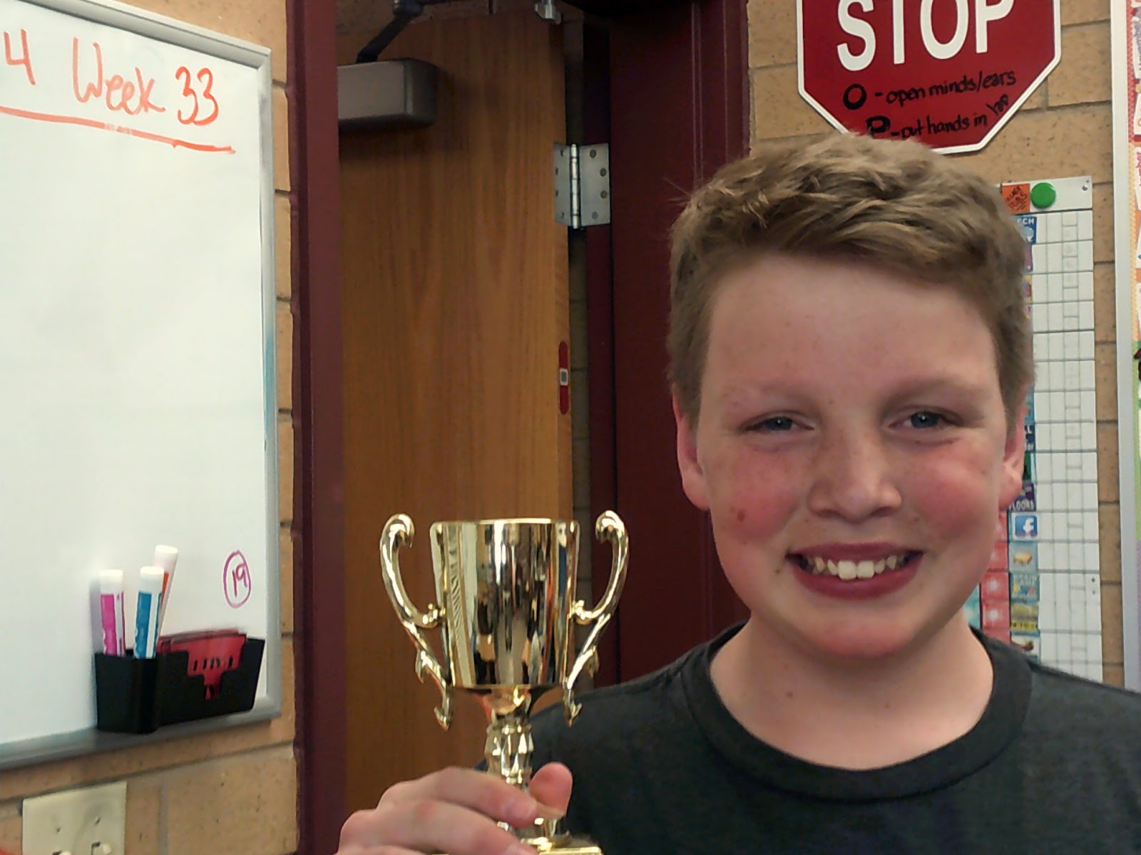
Images on slides 7-14 provided by Mr. Mendenhall’s sixth-grade class, Rees Elementary, Spanish Fork, Utah.

Slide 14
Photography Tips
Hold your camera still.
Focus on your subject matter.
Look for different perspectives.
Shoot at a subject’s eye level.
Find frames.
Use leading lines.
Wikimedia Commons

