Slide 1
Perfection is Messy!
Steve Smith, Ph.D.

Slide 2
Four Strategies
Self-Efficacy not Self-Esteem
Get rid of “musts”
Allow for “messiness”
Reward persistence

Slide 3
1. Self-Efficacy not Self-Esteem
Self-efficacy refers to an individual's belief in his or her capacity to execute behaviors necessary to produce specific performance attainments (Bandura, 1977, 1986, 1997). Self-efficacy reflects confidence in the ability to exert control over one's own motivation, behavior, and social environment. These cognitive self-evaluations influence all manner of human experience, including the goals for which people strive, the amount of energy expended toward goal achievement, and likelihood of attaining particular levels of behavioral performance. Unlike traditional psychological constructs, self-efficacy beliefs are hypothesized to vary depending on the domain of functioning and circumstances surrounding the occurrence of behavior.

Slide 4
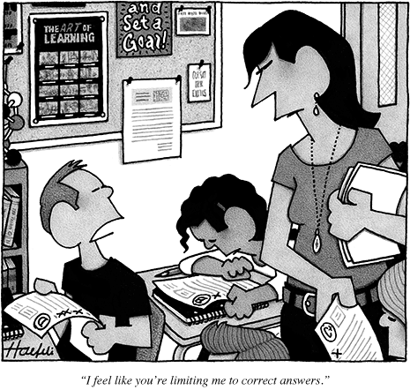
Components of Self-Efficacy
Performance Accomplishments (Mastery)
Vicarious Experience
Verbal Persuasion
Emotional & Physiological States

Slide 5
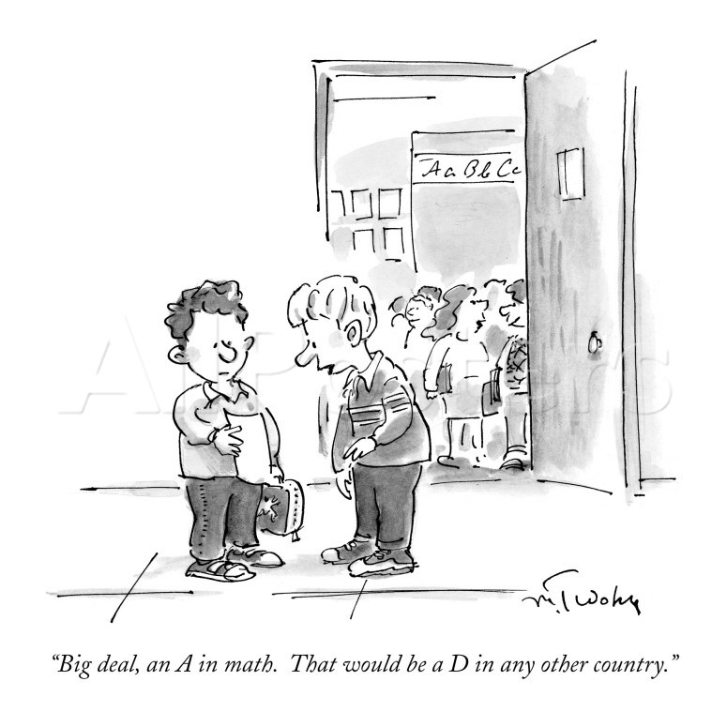
2. Get rid of “musts”
I must perform well at all times
I must never get less than an A
I must never be a disappointment to myself or others

Slide 6
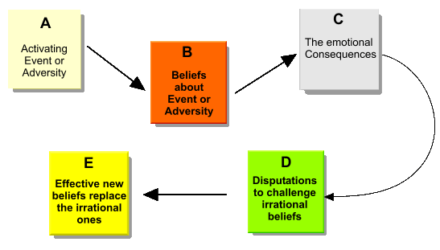
The ABC Model
Activating Event
Belief
Consequence
Disputation
Effective Alternative

Slide 7
Some effective alternatives
I must perform well at all times
I must never get less than an A
I must never be a disappointment to myself or others
Because I’m human, performing well at all times is not possible
Grades are not a determinant of my worth, my value, or my ability to succeed
It is inevitable that I will be disappointed in life, and avoiding disappointment is not always in my best interest

Slide 8
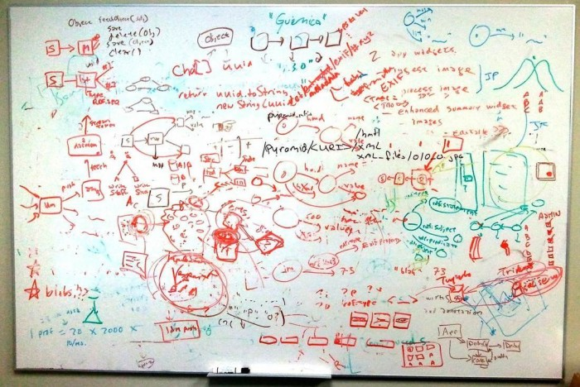
“messiness A”llow for .3

Slide 9
More “Musts”
My students must understand quickly
My students’ quick understanding is a direct reflection of my teaching effectiveness
My students must like me
Students, even gifted ones, will learn at different rates
My students’ learning is a function of my teaching and their investment
It is preferable that my students like me but more important that they respect me

Slide 10
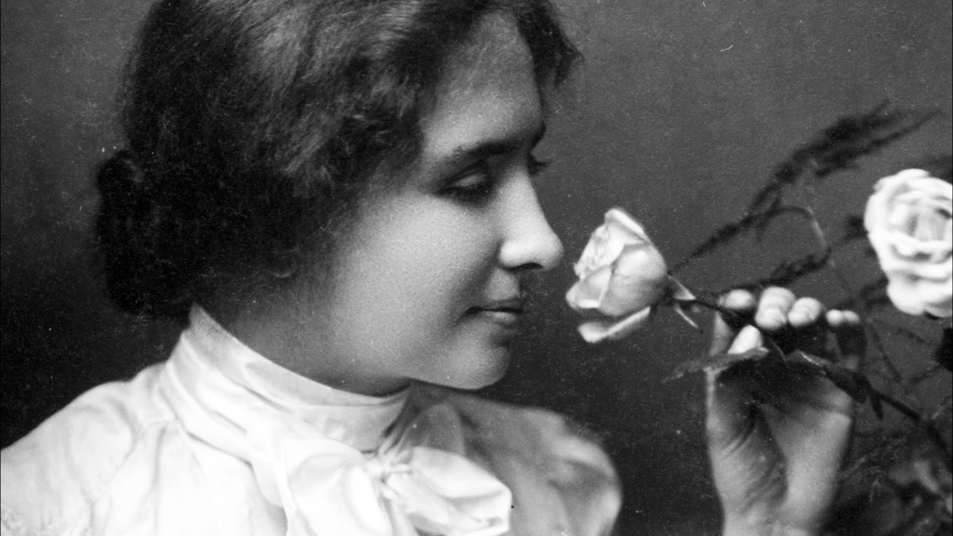
A Culture of “Failure”
I expect you will fail in your first attempts and we will celebrate when you do
I expect that you will learn from your failures and we will celebrate when you do
I expect that you will learn concepts at different rates, and I will honor your individual process

Slide 11
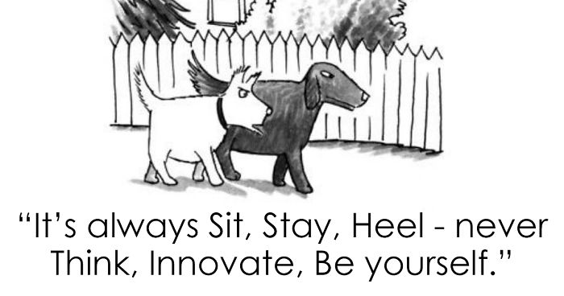
4. Reward persistence
Bloom & Mastery Learning:
Bloom suggested that although students vary widely in their learning rates and modalities, if teachers could provide the necessary time and appropriate learning conditions, nearly all students could reach a high level of achievement.

