Slide 1
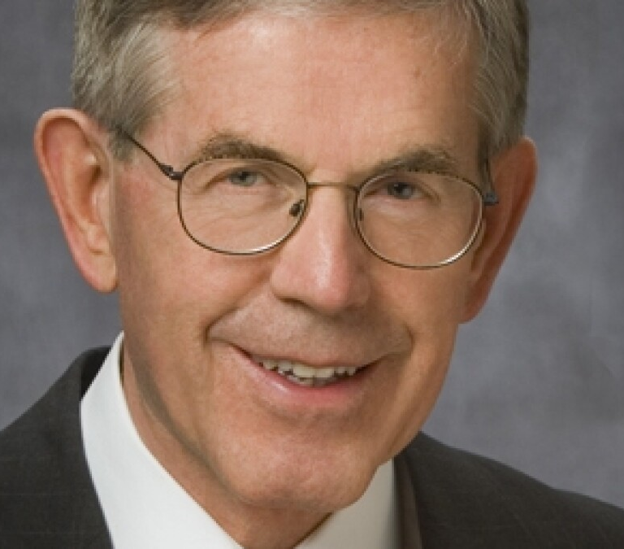
The Dream Is Ours to Fulfill
Bruce C. Hafen

Slide 2
The faith-verses-reason dilemma
“How do we handle the natural confrontations between the sacred and our deep commitment to being a serious university?” (p. 203)
Notes:
Integration of religious and professional aspirations (p. 201)

Slide 3
Chaim Potok’s responses to sacred & secular confrontation:
(p. 203)
“Lockout:” throw up barriers between the two and stay in just one system
“Compartmentalization:” separate categories of thought that coexist in a tenuous peace
“Fusion:” take down all walls. Sacred and secular cultures freely feed each other can lead to radical new culture
“Ambiguity:” take down most walls. Accept a multitude of questions without intending to resolve them.

Slide 4
Chaim Potok’s responses to sacred & secular confrontation:
(p. 203)
“Lockout:” throw up barriers between the two and stay in just one system
“Compartmentalization:” separate categories of thought that coexist in a tenuous peace
“Fusion:” take down all walls. Sacred and secular cultures freely feed each other can lead to radical new culture
“Ambiguity:” take down most walls. Accept a multitude of questions without intending to resolve them.

Slide 5
Ambiguity
Accept a multitude of questions without intending to resolve them.
Notes:
What is your initial reaction to this? I’m a researcher and a type-A personality. I want to KNOW things!

Slide 6
True or False?
The hallmark of discipleship is certainty.
True discipleship is marked by uncertainty.
*Hence the need for faith.

Slide 7
The Eternal Perspective
Alma’s Map of the Universe
Korihor’s Map of the Universe
Notes:
Alma’s map is broader.... Alma doesn’t have the answer to every question, but he does see and accept the same scientific evidence that Korihor does. Beyond that, he also recognizes evidence of personal meaning and spiritual reality that Korihor’s map by definition excludes
We can integrate a secular map into the broader sacred map, but our sacred system cannot be made to fit within the smaller secular map.

Slide 8
“Western culture’s version of learning suffers from ‘one-eyed education.’”
What does this mean to you?
How have you seen this in your sphere of influence at BYU?

Slide 9
Puzzle Metaphor

Slide 10
Talk to Each Other:
What does “wholesighted teaching, with both eyes open” (p. 209) mean to you?
Notes:
Wholesighted teaching moves students “from dogmatism through healthy skepticism toward a balanced maturity that can tolerate ambiguity without losing the capacity for deep commitment.

Slide 11
Wholesighted teaching [learning] moves students “from dogmatism through healthy skepticism toward a balanced maturity that can tolerate ambiguity without losing the capacity for deep commitment.”
(p. 209)

Slide 12
Wholesighted Teaching & Learning
“as my two eyes make one in sight”
Robert Frost
The aim of wholesighted education, anchored in a heart that guides the mind, is wholeness.

Slide 13
How do/can you encourage wholesighted teaching/learning in your sphere at BYU?
Self Reflection

Slide 14
Special Education Metaphor

