Slide 1

APA REVIEW
SESSION

Slide 2


Agenda
1
resources
2
checklist - common mistakes
3
approval process
4
questions

Slide 3

Resources

Slide 4

  APA Manual
  APA Website
    guidelines - extra examples
    handouts
    tutorial videos
  Templates - found on the MSE website
  Checklist
    MSE checklist is turned in with the completed thesis and includes the basic format and conventions of APA
    Department checklist – includes list of common mistakes
  Research and Writing Center
    one-on-one consultations

Slide 5

Checklists & Common Mistakes

Slide 6
Common Mistakes
  Title Page and Abstract Page - line spacing, correct names, “masters of arts”, title length
  Table of contents - page numbers begin, “TITLE PAGE” not thesis title, accurate page numbers and links
  List of Tables/Figures - hyperlinked, accurate page numbers
  Headings
  Chapter 1 starts on page 1
  Abbreviations - after the first use, only use the abbreviation
  IRB approval forms are required
  Figures/tables & corresponding notes must be on the same page
  Figures and tables are ordered by mention

Slide 7

Common Mistakes Cont.
  Widowed/orphaned lines/headings
  Pronouns - your thesis is your work, not a group project
  Italics - not used for emphasis but to highlight a key term or phrase the first use (subsequent uses are not italicized)
  Quotation marks - generally used only for quoted material and not to hedge or downplay meaning or to create emphasis
  EN dashes, hyphens, and EM dashes - knowing when to use each of these
  Reference list - alphabetical, include DOIs, capitalization
  In-text citations - include author, year, and page number (if available)

Slide 8

MSE
college checklist - must be completed and turned in with your completed thesis for review
Department
additional resource with examples of APA requirements

Slide 9

Title Page/Preliminary Pages:
  Line spacing - use the template to ensure line spacing is identical. Pay special attention whether a section is double spaced or single spaced
  The name listed should match your name in AIM (no nicknames, shortened names, married names, etc. Nothing that differs from the official name listed in AIM)
  Title may not exceed 6 inches on one line - titles longer than six inches will need to be on more than one line formatted as an inverted pyramid (longest line on top, shortest on the bottom)
  Choose correct degree name (Teacher Education is “Master of Arts”)
  Correct spelling of chair and committee names
  Do not include page numbers

Slide 10
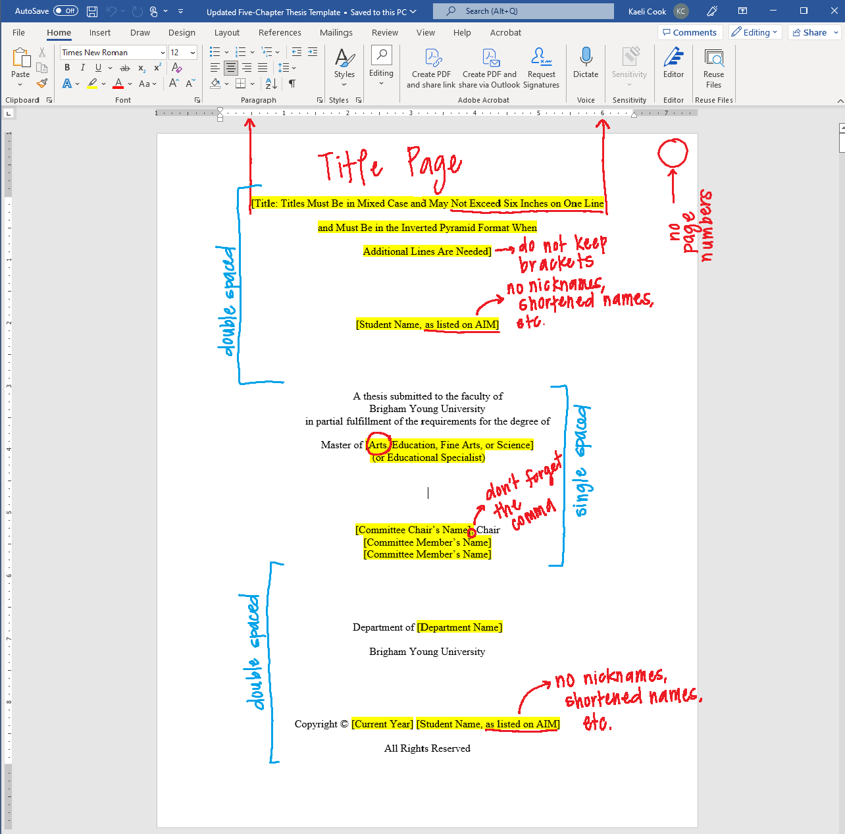

Slide 11

Abstract:
  Single spaced
  Title should not exceed 6 inches on one line
  Keywords on the bottom line of the page
  See template for what to include in the abstract

Slide 12
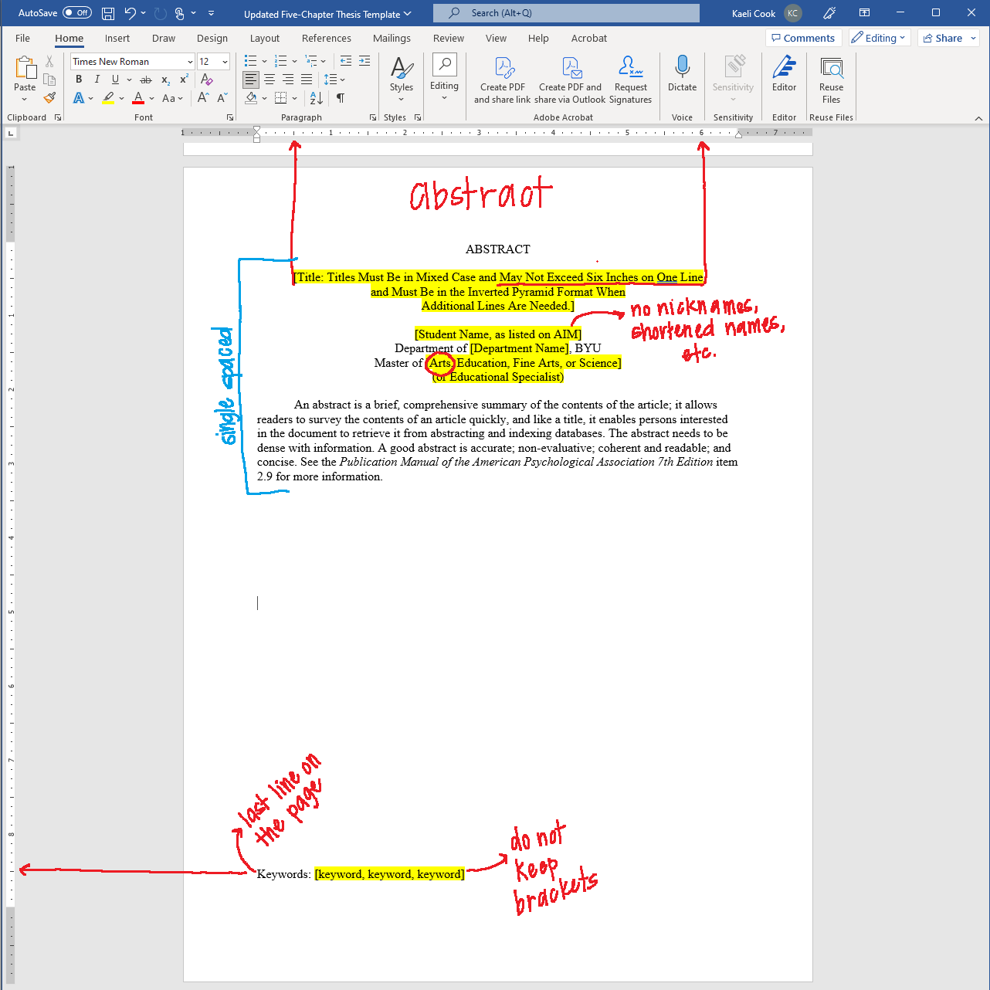

Slide 13

Table of Contents:
  Page numbers being (lower case roman numerals)
  “TITLE PAGE” not actual title of thesis
  Links and page numbers should be accurate
  Headings up to level 3 are included
  Font size and type consistent with the rest of the thesis
  See template for proper formatting of table of contents

Slide 14
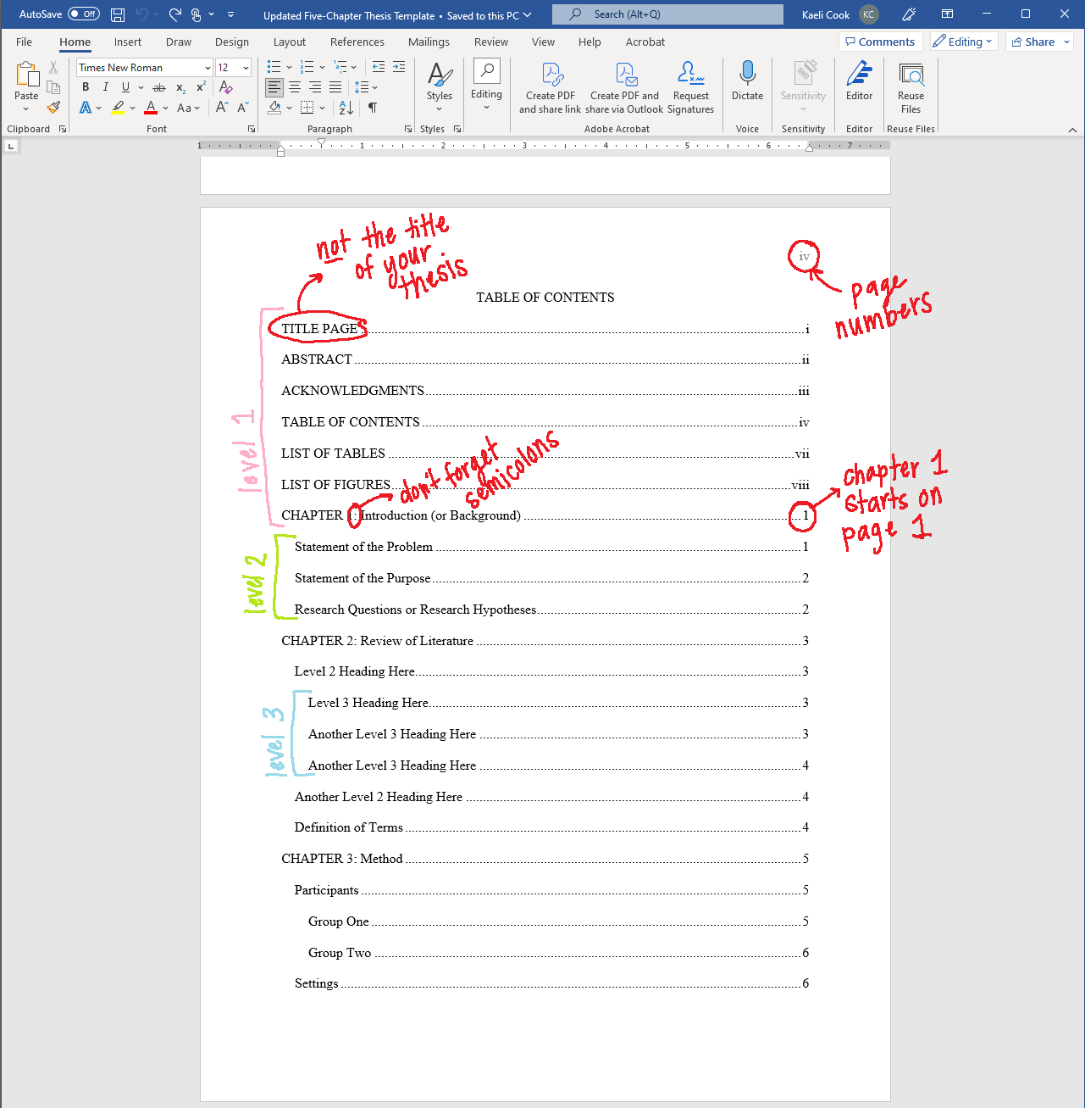

Slide 15

List of Tables/List of Figures
  Links should be hyperlinked
  Correct spacing between “table/figure #” and title of figure/table - see template for proper formatting
  Titles should be title case

Slide 16
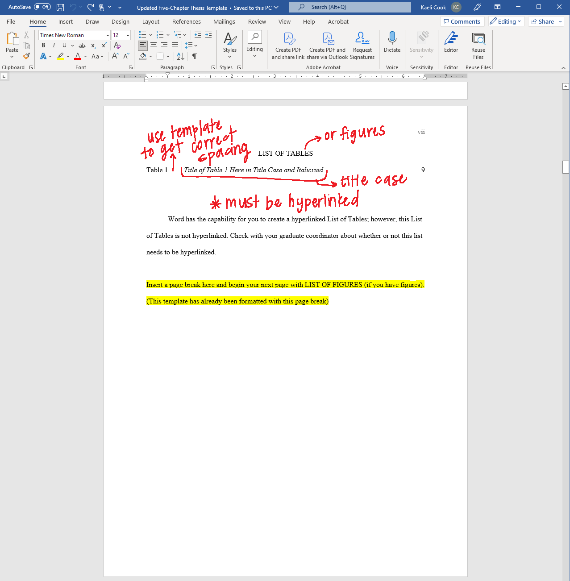

Slide 17

Description of Thesis:
(if necessary)
  Include the name of the journal you are submitting to
  include any special requirements for submission (running head, length, location of tables and figures)
  Explanation of appendices

Slide 18
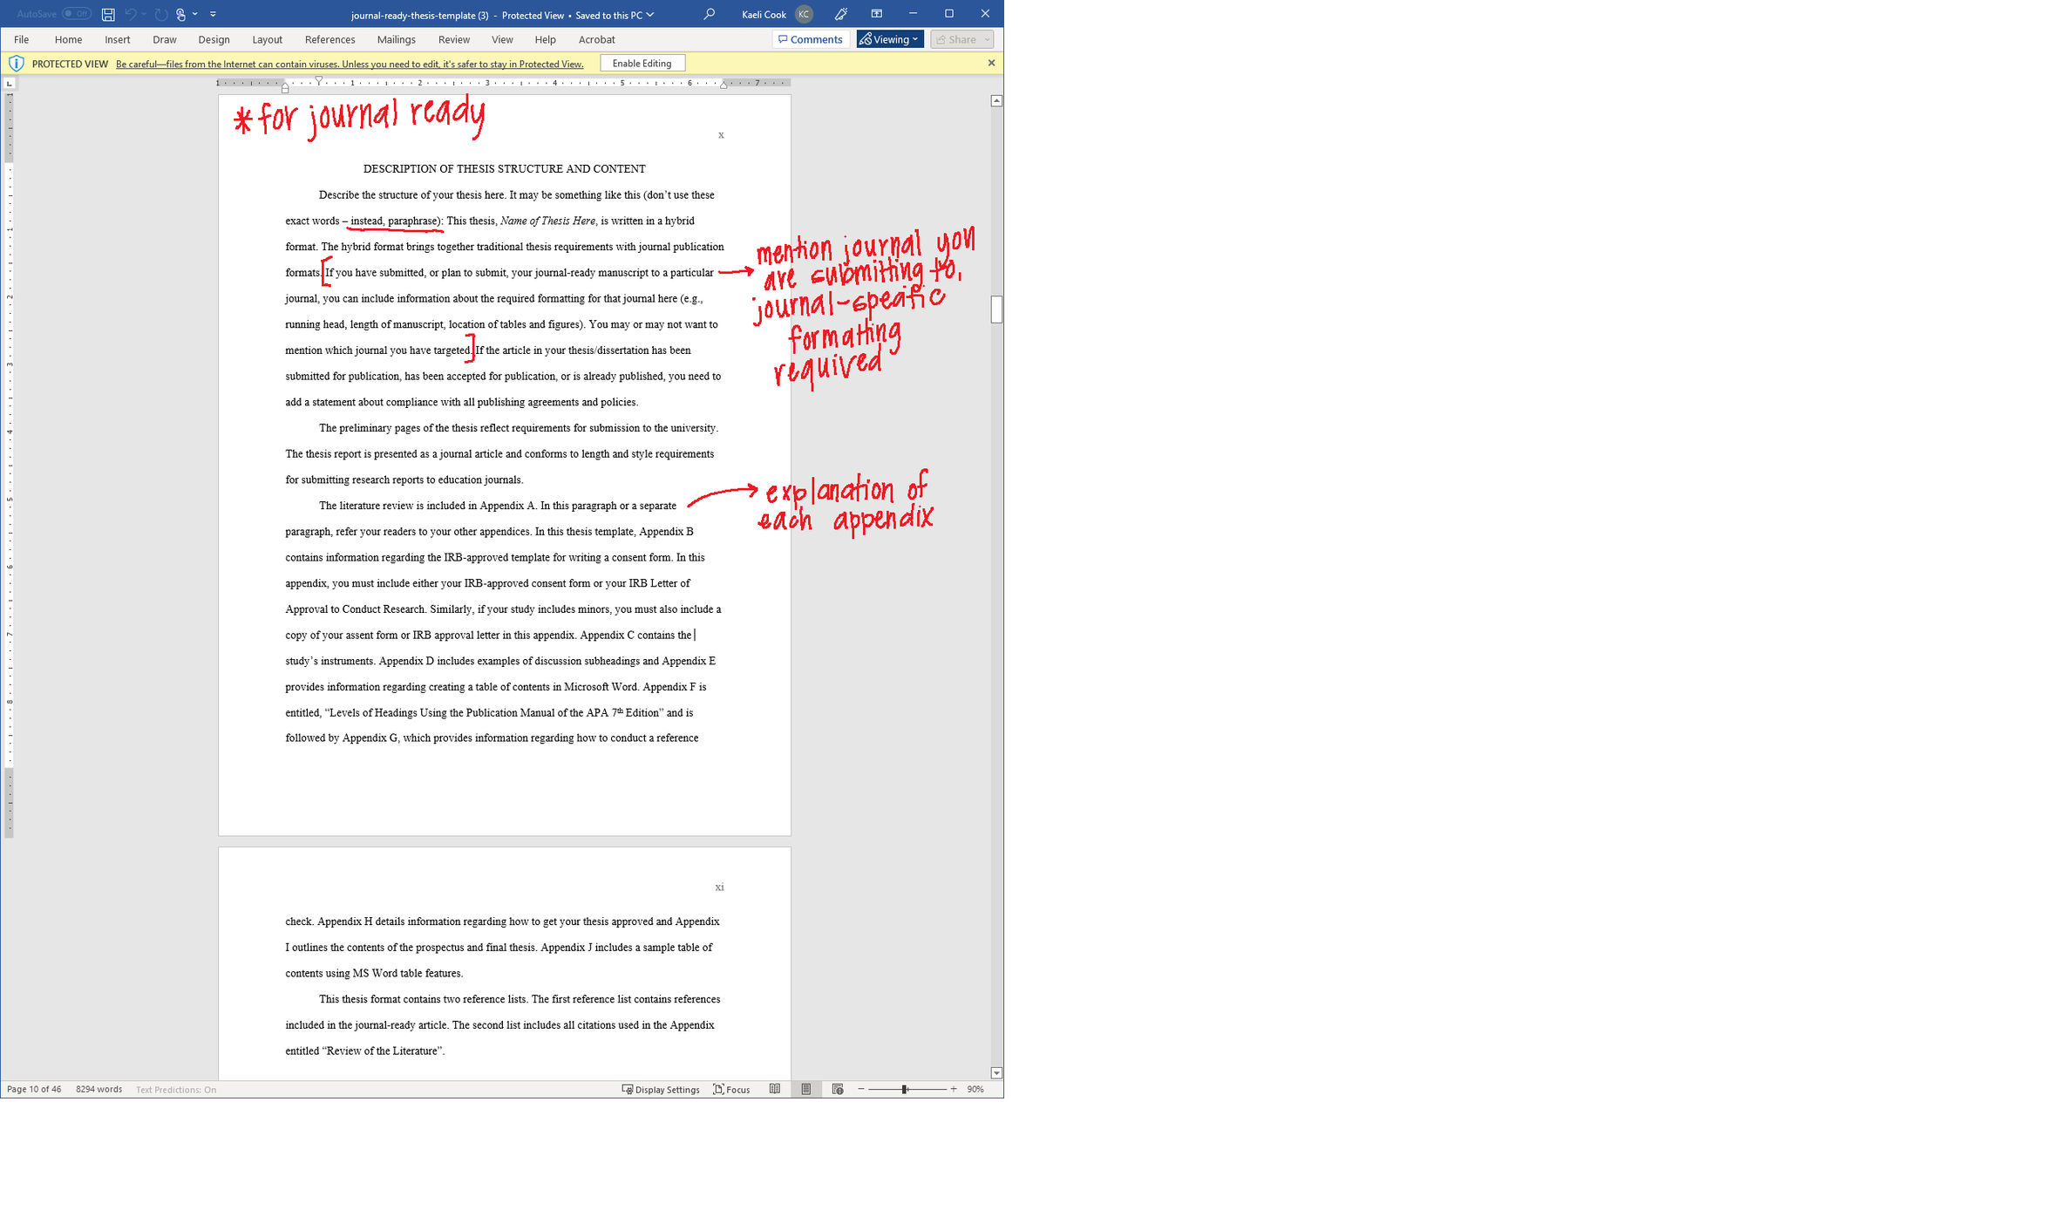

Slide 19

Body of Thesis:
  Chapter 1 starts on page 1; page numbers should be in the upper right-hand corner
  Half-inch paragraph indentation
  Single-space after periods
  Widows and orphans corrected - one line/heading at the end of a page or one line/heading at the beginning of a page
  Abbreviations - after the first introduction of an abbreviation use only the abbreviation (see further rules in APA 6.24)
  Italics - most commonly used for anchors of scales, key terms or phrases (see rules in APA 6.22; note: not used for mere emphasis)

Slide 20
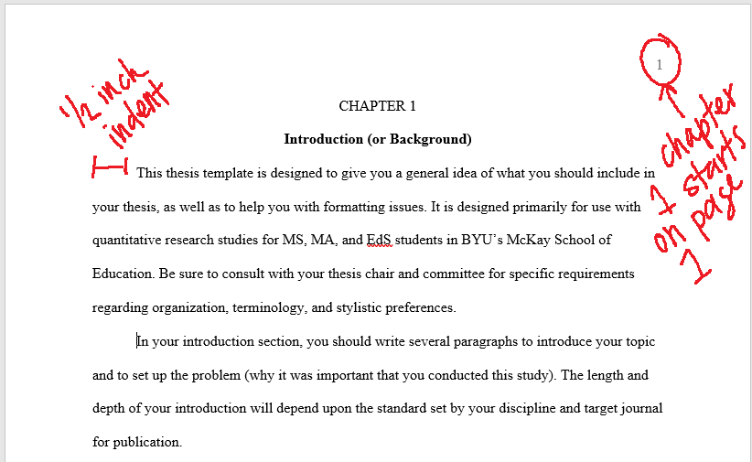

Slide 21
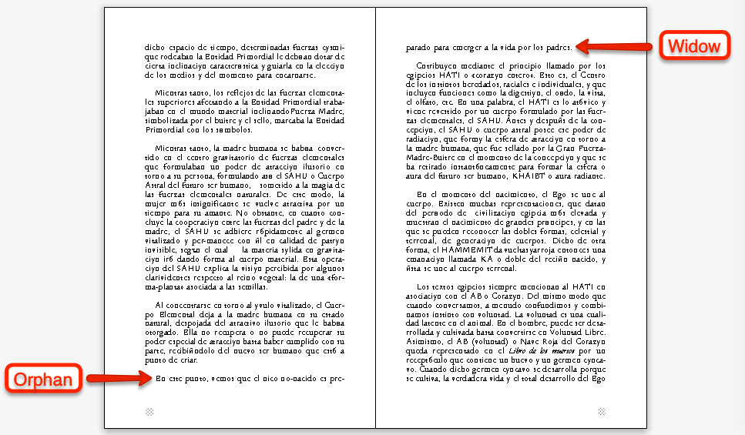

Slide 22
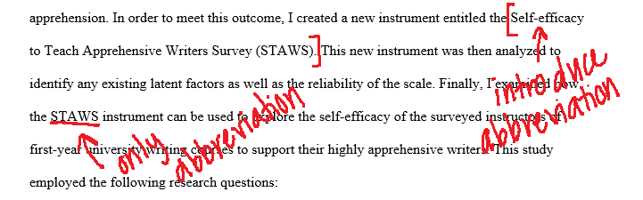

Slide 23
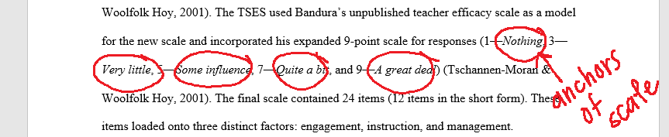
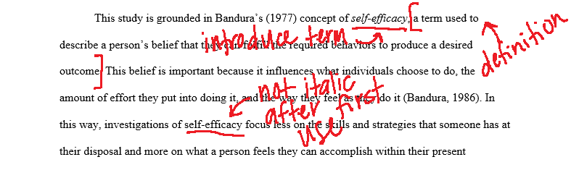

Slide 24

Body of Thesis Continued:
  Quotation Marks - most commonly used for quoted material, first introduction of a word or phrase used ironically/slang/invented or coined phrase, introduce a label (see rules in APA 6.7; note: not used to highlight key terms or to hedge/downplay meaning)
  Be consistent with tense - methods section should be past tense and the rest present tense
  Pronouns - avoid third person and the editorial “we”, your thesis is your work (APA 4.16-4.17)
  Format lists correctly - see APA 6.49
  Numbers 0-9 should be written out (see exceptions APA 6.32)

Slide 25
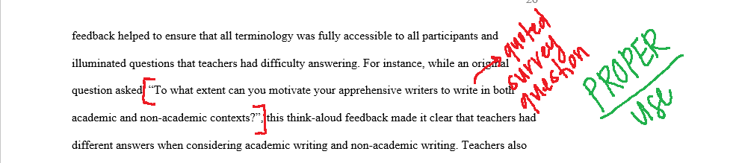
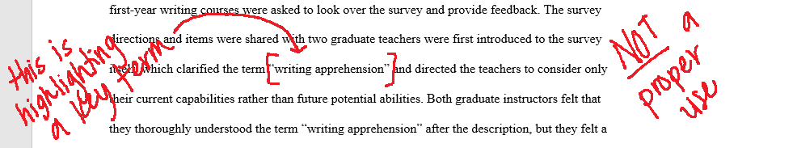
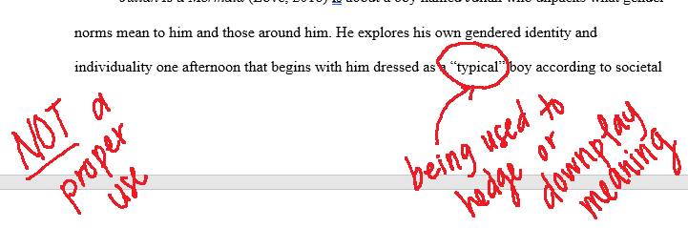

Slide 26
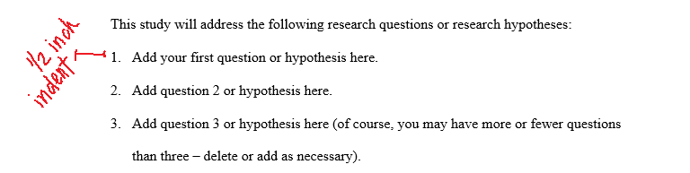
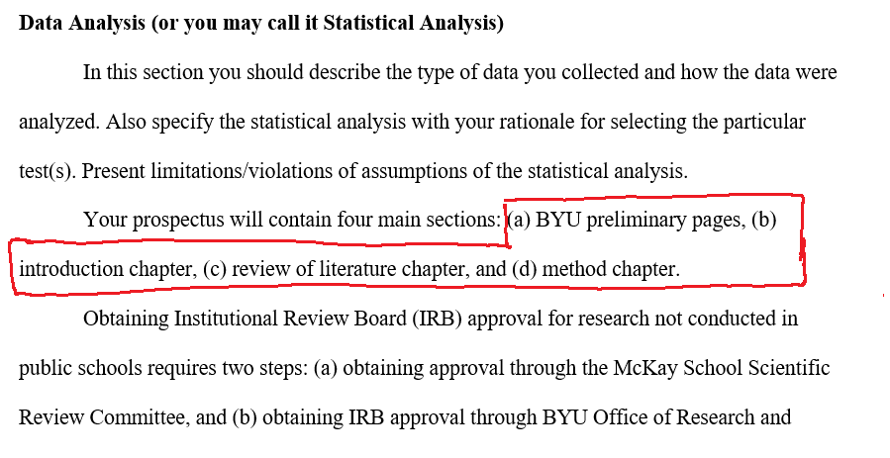

Slide 27
Body of Thesis Continued:
  Verbs and pronouns need to match - singular versus plural is the most common issue (APA 4.15)
  En dash (separates equivalent relationships like page ranges and dates) versus em dash (create emphasis by separating a phrase) versus hyphen (compound words) - make sure you are using correc tone (APA 6.1 & 6.14)
  Quotations under 40 words are put in the paragraph. Quotations more than 40 words are formatted as block quotes. See APA 8.27
  Avoid one-sentence paragraphs
  Ellipses are not used at the beginning or the end of quotes unless the quoted material includes one

Slide 28
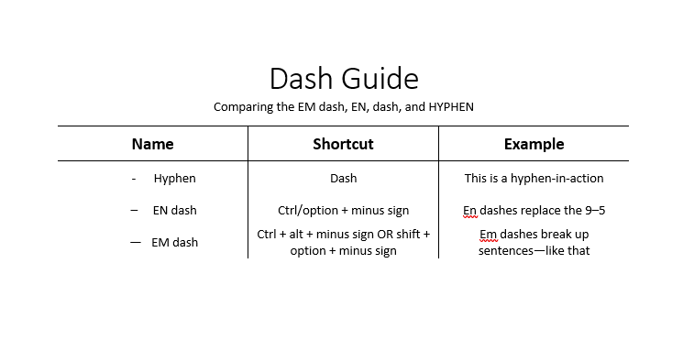

Slide 29
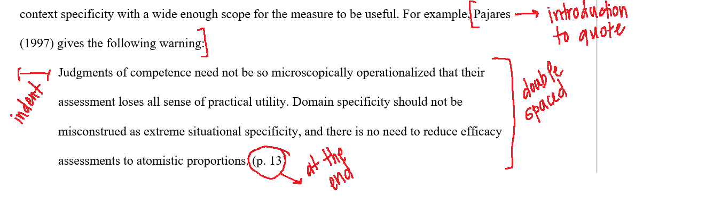

Slide 30

Headings:
  Each level formatted correctly - APA 2.27
  Headings must be subdivided into at least two sections - See APA 2.26
  Headings must be “styled” with the proper heading style - headings should all appear in the navigation pane, or the thesis will not properly export the table of contents in the pdf

Slide 31
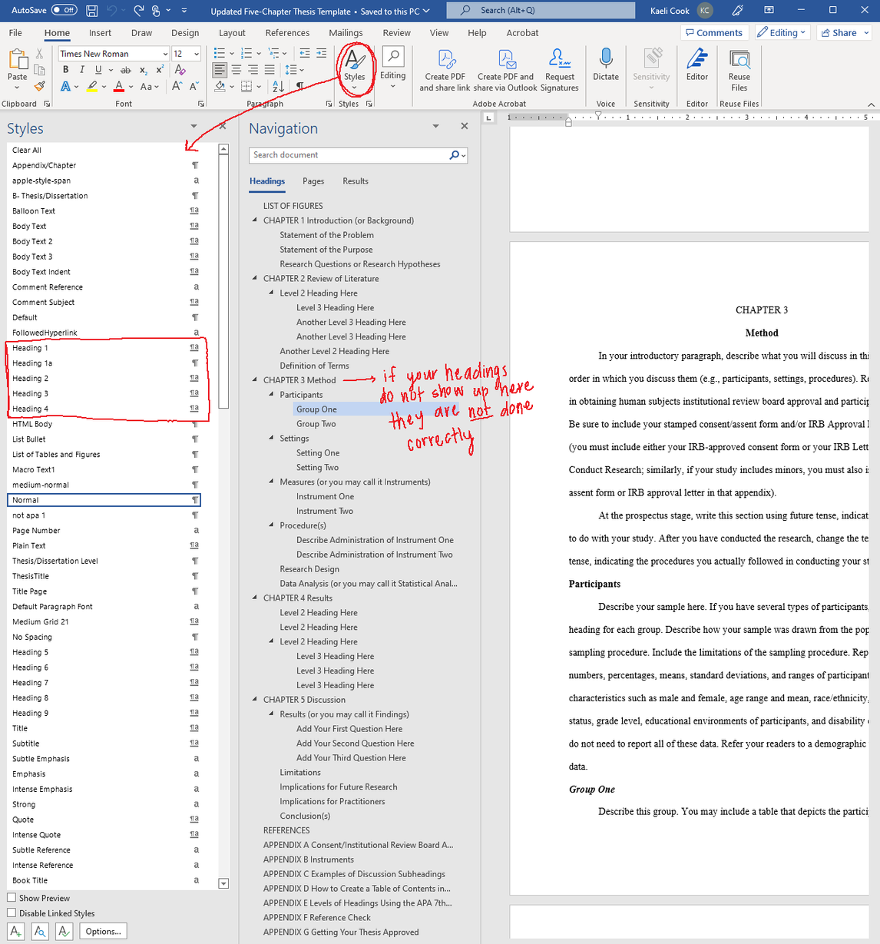

Slide 32
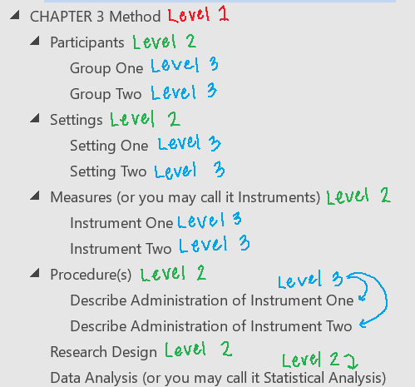
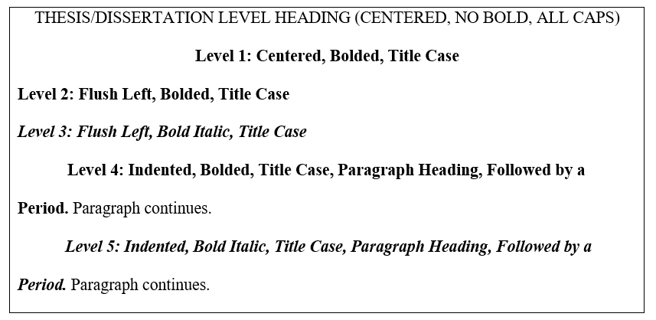

Slide 33
Tables & Figures:
  Information adds to the thesis rather than restates
  Figure numbers on first line and bolded, figure titles on next line and italicized
  Tables/figures placed right after callout in thesis (or as close as possible)
  Review checklist for tables and figures at APA 7.21 & 7.35
  Table and figure notes should be double spaced and on the same page as the table/figure (add citation information when needed in the note)

Slide 34
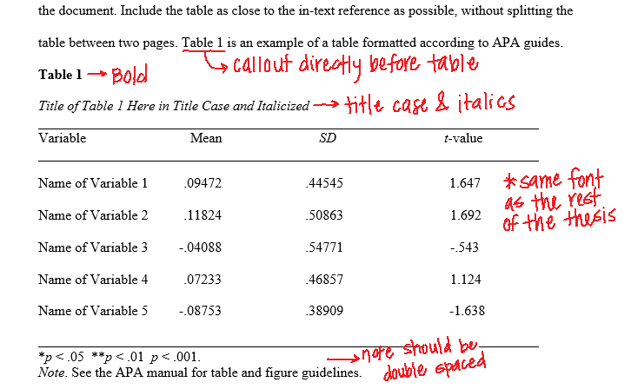
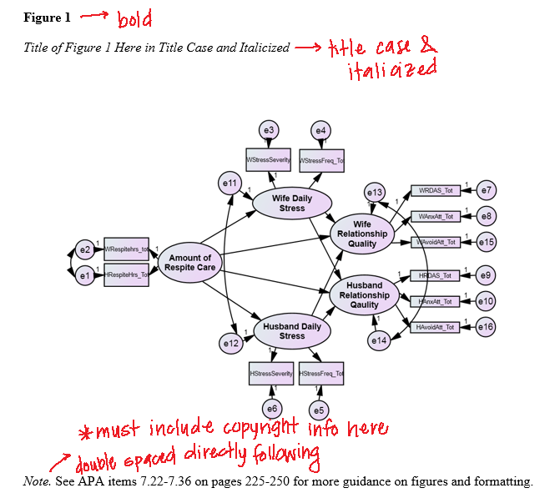

Slide 35

In-Text Citations:
  Listed alphabetically when citing more than one article
  More than two authors, include the first author, et al
  Include year and page number (if applicable)
  Narrative citations include year directly following the author in parentheses

Slide 36
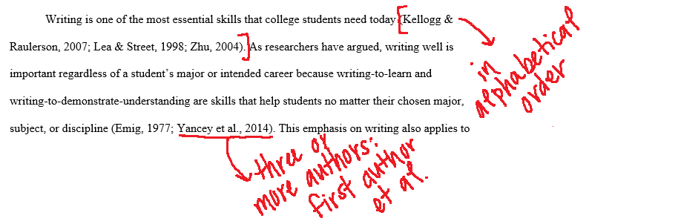



Slide 37

Reference List:
  Double spaced
  Hanging indent
  Alphabetical by first author, then second author (etc), then by year
  DOIS or stable URLs if they exist (note: some books will have DOIs) - do not include a period at the end of a DOI or a URL
  En dashes - used for ranges of numbers like page numbers (APA 6.6)
  Include up to 20 authors, for 21+ authors you include the first 19 authors … & the last author
  Titles of books and journal articles should be formatted in sentence case
  Double check whether a period or a comma is necessary
  More than one author, use an ampersand (&) between the names

Slide 38
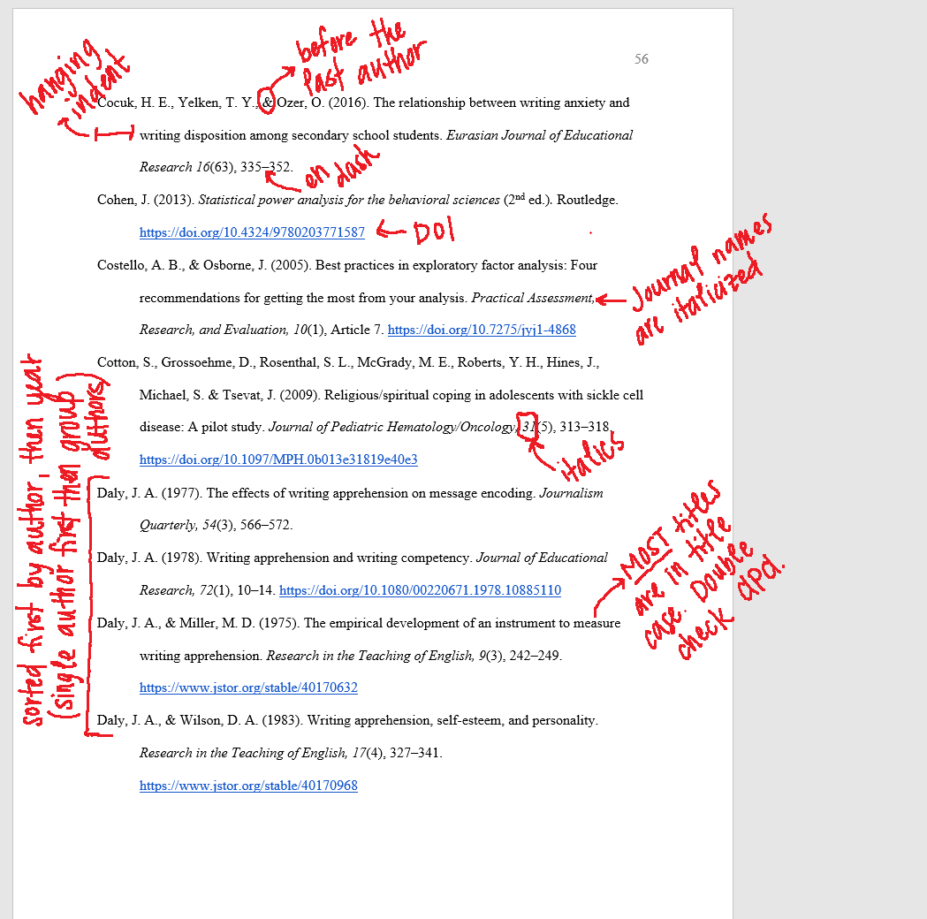

Slide 39

Appendices:
  List in order you introduced in the thesis - Appendix A should be the first one referenced
  Include copy of stamped consent/assent forms and IRB Approval to Conduct Research (if applicable)
  Consistent formatting with the rest of the thesis (12-point font, 1-inch margins, etc)

Slide 40

Approval Process

Slide 41

Approval Process
Program Manager
Program Coordinator
Dean’s Office
University
Focuses on APA and formatting - iterative process
Overall approval - APA, formatting, flow, clarity
Final approval - formatting of preliminary pages, ETD
Focuses on content clarity and flow, supports APA and formatting

Slide 42





Submission Checklist
Links in Table of Contents, List of Figures, & List of Tables
Widowed and Orphaned headings/lines
Page Numbers

Slide 43

Questions

